Slide 1







TEAM NAME : WATERVATION
WATER FOOTPRINT CALCULATOR
CHY1006 - Environmental Sustainability
Teacher : Dr. Saurav Prasad
Interim-Semester 2024-25

Slide 2






GROUP MEMBERS :
Anshul Shukla (23BCE10529)
Aditya Mazumder (23BCE10492)
Vinay Gore ( 23BSA10003 )
Ayush Jha (23BCE10592)

Slide 3
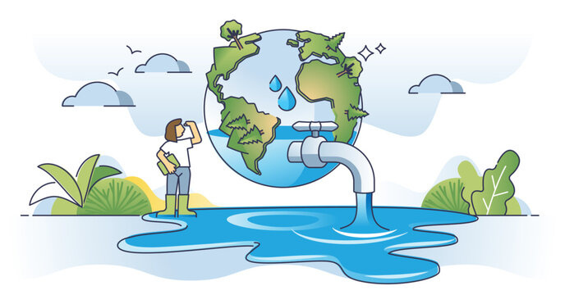

INTRODUCTION
What is a water footprint calculator
A water footprint measures the total volume of freshwater used to produce goods and services consumed by an individual, community, or nation.
It is a crucial indicator of water usage, helping to understand the impact of our consumption on global water resources.
Managing water footprints is essential for sustainability, as it promotes efficient water use, reduces environmental impact, and ensures the availability of water for future generations.

Slide 4

The Water Footprint Calculator is a tool designed to measure the total water usage associated with an individual, product, or activity.
Its purpose is to promote sustainable water management by helping users understand their water consumption patterns.
By using the calculator, users can gain insights into their water usage and take steps to reduce their water footprint, contributing to a more sustainable future.
Website link : https://adityamazumder.github.io/Water-Foot-print-Calculator/

Slide 5

FEATURES
We have mad a persenal water footprint calculator , which finds out the water conumption of a person in one week . It takes into account all the usual activites performed by person over the course of a week . The following are the features of our water footprint calculator :
Easy to Navigate:
User-friendly interface designed for a smooth experience.
Various Categories:
Covers multiple aspects of daily life, including Bathroom, Kitchen, Laundry, and more, to provide a comprehensive water usage assessment.
Actionable Insights and Tips:
Offers personalized insights and practical tips to help users reduce their water footprint and adopt more sustainable practices.
Spreads awareness about water conservation techniques
Minimalistic no-nonsense user interface
Provides simple straight-forward instructions
User Instruction : We request you to please click on the next button after you complete your answer , pressing enter will not move the website forward .

Slide 6

WORKING OF THE WEBSITE
We have used programming language c++ for making the backend framework , which is the main brain of the water footprint calculator .
For making the website framework and designing the website we have used HTML and css programming.
For Integrating the backend c++ code with the frontend we have used Python (using Flask).
GITHUB lINK : https://github.com/AdityaMazumder/Water-Foot-print-Calculator

Slide 7
WORKING OF THE BACKEND PROGRAM
Here's an explanation of the code in five key points:
Classes and Objects:
The code defines classes like Activity and User to represent different water-using activities and the users performing them.
The Activity class stores the name and water usage associated with a particular activity, while the User class tracks the activities a user performs along with their frequency.
Adding Activities:
The User class allows adding activities via the addActivity method, which takes an Activity object and the frequency of that activity. These are stored in a list within the User class.
Water Footprint Calculation:
The User class has a method called calculateTotalWaterFootprint. This method calculates the user's total water footprint by multiplying the water usage of each activity by its frequency and summing the results.
Initialization of Activities:
The WaterFootprintCalculator constructor initializes a list of predefined activities (e.g., "Taking a bath", "Bathroom sink") that users can select from when calculating their footprint.
User Interaction:
The code utilizes standard input/output streams (std::cin, std::cout) to interact with the user, allowing them to select activities and input the frequency of those activities to calculate their water footprint.

Slide 8
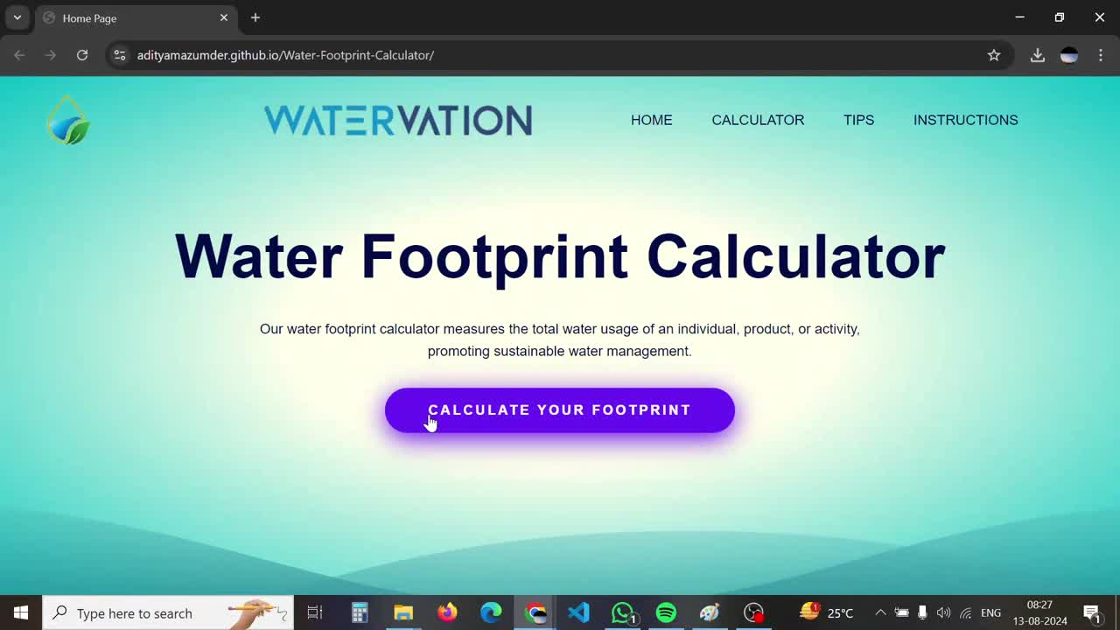
WORKING OF THE WEBSITE

Slide 9

RAISING AWARENESS & PROVIDING TIPS
Beyond Calculation:
The Water Footprint Calculator goes beyond just measuring water usage; it also educates users on the importance of water conservation.
Practical Tips:
After calculating your water footprint, the tool offers personalized tips and suggestions to help you reduce water usage in various areas of your life.
Empowering Users:
By providing actionable insights, the tool empowers users to make informed decisions and adopt sustainable practices in their daily routines.
Focus on Sustainability:
The ultimate goal is to promote sustainable water management and raise awareness about the critical need to conserve our precious water resources.

Slide 10

Importance of the Water Footprint Calculator:
The Water Footprint Calculator is a vital tool for understanding and managing your water consumption. By using this tool, you gain insights into your water usage and its environmental impact.
CONCLUSION
ENCOURAGEMENT:
We encourage yOU TO REGULARLY USE THE WATER FOOTPRINT CALCULATOR TO MONITOR YOUR PROGRESS AND CONTINUE REDUCING YOUR WATER USAGE. EVERY SMALL CHANGE MAKES A BIG DIFFERENCE IN CONSERVING OUR PLANET'S WATER RESOURCES.
Contributing to Sustainability:
Regularly assessing your water footprint helps you make informed choices that contribute to sustainable water management, ensuring the availability of this essential resource for future generations.

Slide 11
Thank You

